Slide 1
Pushing at the back

Slide 2
Outline
In this lesson, we will:
Understand how to push a new entry onto the back of the linked list
Determine how we can speed this up
Understand that the cost is
A negligible slow-downs in other member functions
One more member variable

Slide 3
Our linked list class
Reviewing our linked list class
class Node;
class Linked_list;
class Linked_list {
public:
Linked_list(); // Constructor
~Linked_list(); // Destructor
bool empty() const;
std::size_t size() const;
int front() const;
void print() const;
std::size_t find( int datum ) const;
void push_front( int datum );
bool pop_front();
void clear();
private:
Node *p_list_head; // Pointer to head node
std::size_t list_size;
};

Slide 4
Problem
We can only push at the front of the linked list
What happens if we want to push a new node at the back?
We require a push_back() member function
Where might we use this?
Suppose you were waiting in line
You given a unique ID number
Your ID number is pushed on the back of the linked list
When it comes time to service someone who is waiting, the ID at the front of the linked list is called and then popped
This allows for first-come—first-served (fifo)

Slide 5
Pushing at the back of the linked list
We may be either:
Pushing onto the back of an empty linked list
This is the same as pushing at the front
Pushing onto the back of a non-empty linked list

Slide 6
Pushing at the back of an empty linked list
Pushing at the back of an empty linked list:
void Linked_list::push_back( int datum ) {
if ( empty() ) {
push_front( datum );
} else {
assert( size() >= 1 );
}
}

Slide 7
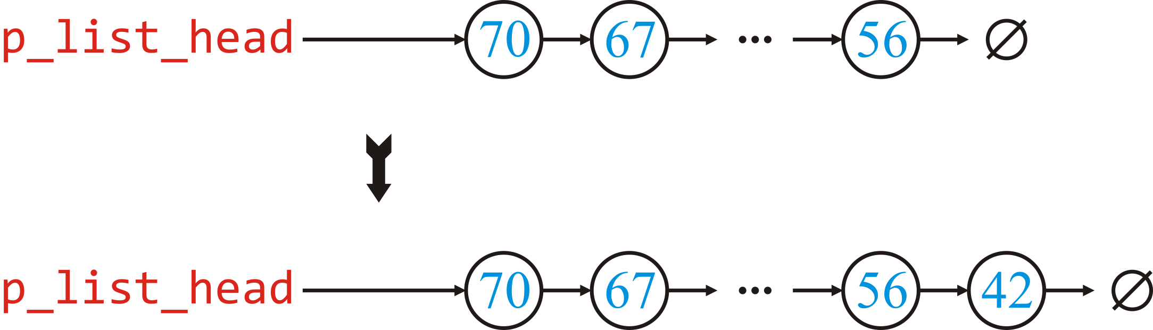
Pushing at the back of a non-empty linked list
Suppose the linked list is not empty and we want to push 42 onto the back of the linked list
We must:
Get a pointer to the last node
Update that node to point to a new node storing the value 42

Slide 8
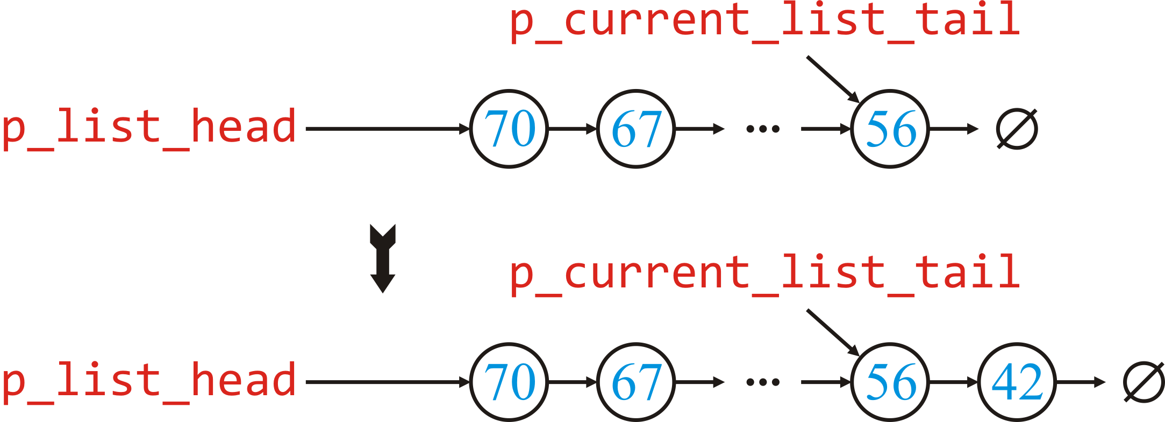
Pushing at the back of a non-empty linked list
In a nutshell, we require:

Slide 9
Pushing at the back of an empty linked list
Pushing at the back of an empty linked list:
void Linked_list::push_back( int datum ) {
if ( empty() ) {
push_front( datum );
} else {
assert( size() >= 1 );
Node *p_current_list_tail{p_list_head};
while ( p_current_list_tail->get_next() != nullptr ) {
p_current_list_tail = p_current_list_tail->get_next();
}
// Now p_current_list_tail' stores the address
// of the last node of the linked list
assert( p_current_list_tail != nullptr );
assert( p_current_list_tail->get_next() == nullptr );
p_current_list_tail->p_next_node = new Node{datum, nullptr};
++list_size;
}
}

Slide 10
Pushing at the back of an empty linked list
Wait: Isn’t p_next_node private?
How do we modify it?
The Node class can declare the Linked_list class to be a friend
class Node;
class Linked_list;
class Node {
public:
// Member functions to access private member variables
Node( int value, Node *p_next = nullptr );
int get_value() const;
Node *get_next() const;
private:
// Let's make them private now ...
int node_value;
Node *p_next_node;
friend class Linked_list;
};
Remember:
Only friends can access
your private members

Slide 11
Pushing at the back of an empty linked list
With friendship, we can access the member variables of the Node class
void Linked_list::push_back( int datum ) {
if ( empty() ) {
push_front( datum );
} else {
assert( size() >= 1 );
Node *p_current_list_tail{p_list_head};
while ( p_current_list_tail->get_next() != nullptr ) {
p_current_list_tail = p_current_list_tail->get_next();
}
// Now p_current_list_tail' stores the address
// of the last node of the linked list
assert( p_current_list_tail != nullptr );
assert( p_current_list_tail->get_next() == nullptr );
p_current_list_tail->p_next_node = new Node{datum, nullptr};
++list_size;
}
}

Slide 12
Can we speed this up?
The loop in pushing at the back is the bottleneck:
We must step through the entire linked list to find the last node
To speed this up, we must keep track of the current tail of the linked list
That is, like p_list_head, we need a p_list_tail member variable
class Node;
class Linked_list;
class Linked_list {
public:
// Public constructor/destructor/member function declarations
private:
Node *p_list_head; // Pointer to head node
Node *p_list_tail; // Pointer to tail node
std::size_t list_size;
};

Slide 13
Can we speed this up?
Again, like with list_size, we may have to update p_list_tail whenever we either:
Add a new node
Erase an existing node

Slide 14
Constructor and destructor
The constructor must initialize the pointer’s value:
Linked_list::Linked_list():
p_list_head{nullptr},
p_list_tail{nullptr},
list_size{0} {
// Nothing else for the constructor to do
}

Slide 15
Inserting a node
When pushing a new node at the front of the linked list, we only have to update the member variable if the list is empty:
void Linked_list::push_front( int datum ) {
p_list_head = new Node{datum, p_list_head};
if ( size() == 0 ) {
p_list_tail = p_list_head;
}
++list_size;
}
Question:
Why can we no longer call empty()?

Slide 16
Removing a node
When popping, we only have to update tail pointer if we’re now empty:
bool Linked_list::pop_front() {
if ( empty() ) {
return false;
} else {
assert( size() >= 1 );
Node *p_previous_list_head{p_list_head};
p_list_head = p_list_head->get_next();
delete p_previous_list_head;
--list_size;
if ( empty() ) {
p_list_tail = nullptr;
}
return true;
}
}

Slide 17
Pushing at the back of an empty linked list
We can now simplify our implementation of push_back(…):
void Linked_list::push_back( int datum ) {
if ( empty() ) {
push_front( datum );
} else {
assert( size() >= 1 );
p_list_tail->p_next_node = new Node{datum, nullptr};
p_list_tail = p_list_tail->get_next();
++list_size;
}
}

Slide 18
Accessing the value at the back
We can now access the back quickly, too:
int Linked_list::back() const {
if ( empty() ) {
std::cerr << "Error: list is empty" << std::endl;
throw nullptr;
} else {
return p_list_tail->get_value();
}
}

Slide 19
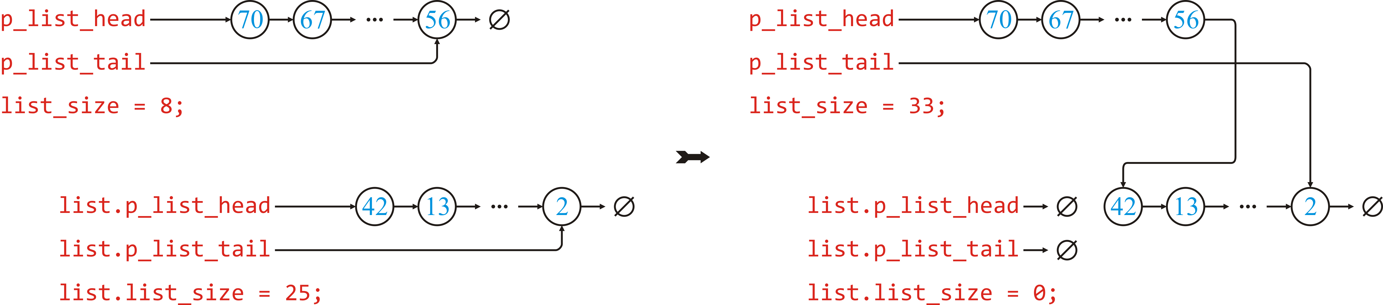
Pushing an entire list at the back
We can now also concatenate another linked list onto this one:
Questions:
Why do we have to empty the second list?
What do we do if the second list is already empty?

Slide 20
Concatenating two linked lists
The implementation is very fast:
void Linked_list::push_back( Linked_list &list ) {
if ( !list.empty() ) {
p_list_tail->p_next_node = list.p_list_head;
p_list_tail = list.p_list_tail;
list_size += list.list_size;
list.p_list_head = nullptr;
list.p_list_tail = nullptr;
list.list_size = 0;
}
}

Slide 21
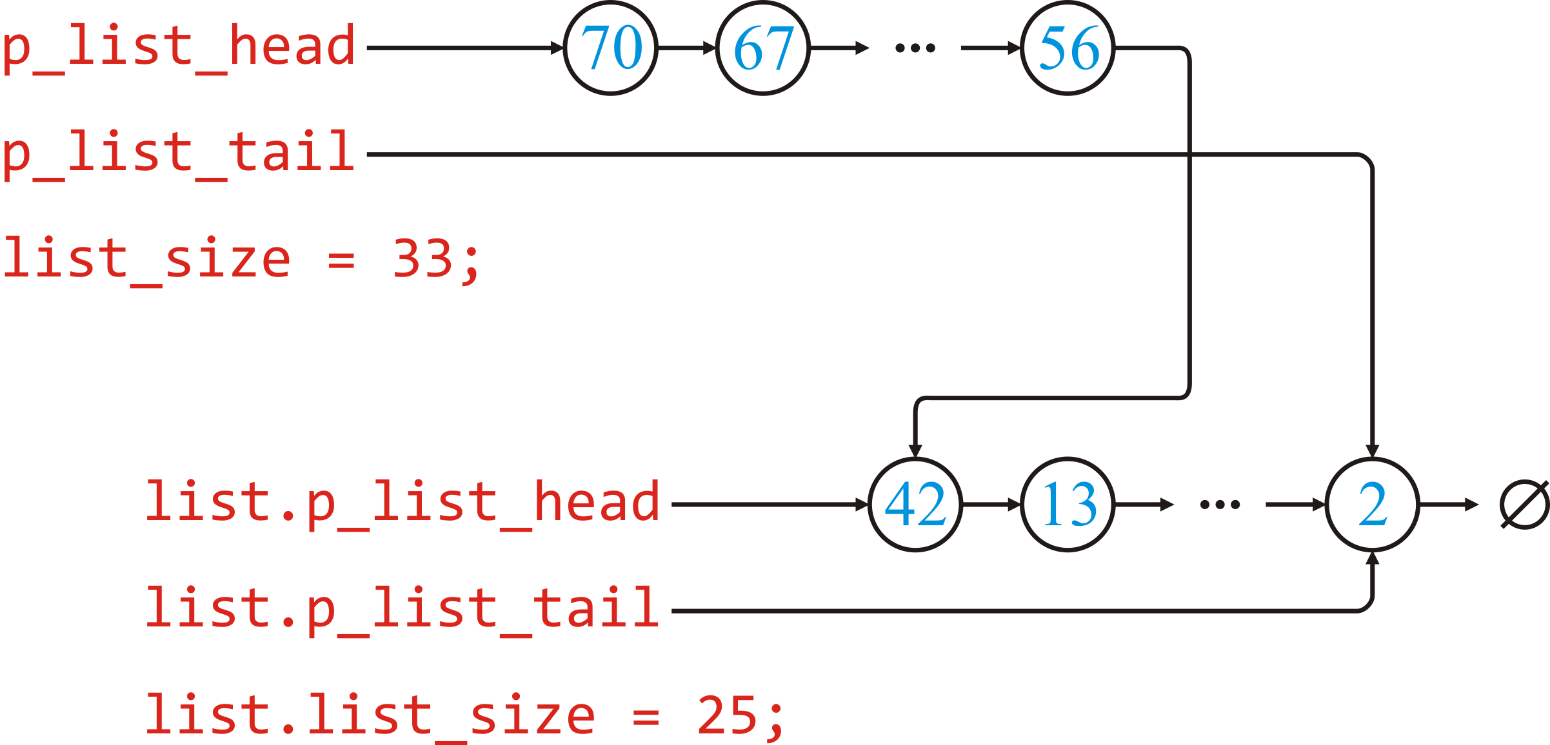
Concatenating two linked lists
Question: What would happen if we did not empty the second list?
void Linked_list::push_back( Linked_list &list ) {
if ( !list.empty() ) {
p_list_tail->p_next_node = list.p_list_head;
p_list_tail = list.p_list_tail;
list_size += list.list_size;
}
}

Slide 22
Our linked list class
Our public member functions have not changed their behavior:
class Node;
class Linked_list;
class Linked_list {
public:
Linked_list(); // Constructor
~Linked_list(); // Destructor
bool empty() const;
std::size_t size() const;
int front() const;
int back() const;
void print() const;
std::size_t find( int datum ) const;
void push_front( int datum );
void push_back( int datum );
void push_back( Linked_list &list );
bool pop_front();
void clear();
private:
Node *p_list_head; // Pointer to head node
Node *p_list_tail; // Pointer to tail node
std::size_t list_size;
};

Slide 23
Benefit of encapsulation
Adding this member variable and modifying our member functions in no way affected the way users interact with this class
The only differences are:
It uses a little more memory (one more pointer)
Some functions are trivially slower (a few extra instructions)
The back() and push_back(…) member function are significantly faster now

Slide 24
Summary
Following this lesson, you now
Know how to add a new node at the back of the linked list
Understand how this can be sped up by adding a new member variable storing the address of the last node
Understand the concept of friend in C++
Know when and how to update this member variable

Slide 25
References
[1] No references?

Slide 26



Colophon
These slides were prepared using the Georgia typeface. Mathematical equations use Times New Roman, and source code is presented using Consolas.
The photographs of lilacs in bloom appearing on the title slide and accenting the top of each other slide were taken at the Royal Botanical Gardens on May 27, 2018 by Douglas Wilhelm Harder. Please see
https://www.rbg.ca/
for more information.

Slide 27
Disclaimer
These slides are provided for the ece 150 Fundamentals of Programming course taught at the University of Waterloo. The material in it reflects the authors’ best judgment in light of the information available to them at the time of preparation. Any reliance on these course slides by any party for any other purpose are the responsibility of such parties. The authors accept no responsibility for damages, if any, suffered by any party as a result of decisions made or actions based on these course slides for any other purpose than that for which it was intended.

